Slide 1
Predicting Lung and Heart Disease From Chest X-Rays
Angad Pfuetzner

Slide 2
The Problem
Can we automate disease detection from chest X-rays to save radiologists countless hours of tedious inspection?

Slide 3


Who Cares?
Doctors
Patients

Slide 4

Data Sources

Slide 5
Data Exploration
112 120 X-ray images
30 805 unique patients
Conditions: Atelectasis, Consolidation, Infiltration, Pneumothorax, Edema, Emphysema, Fibrosis, Effusion, Pneumonia, Pleural Thickening, Cardiomegaly, Nodule, Mass, Hernia

Slide 6
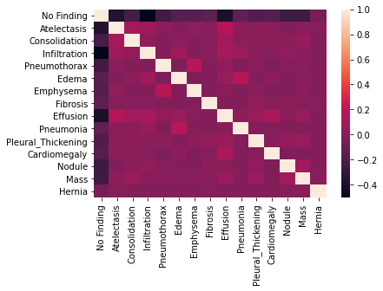

Slide 7
Label | # of Images
No Finding | 60 361
Atelectasis | 11 559
Consolidation | 4 667
Infiltration | 19 894
Pneumothorax | 5302
Edema | 2303
Emphysema | 2516
Fibrosis | 1 686
Effusion | 13 317
Pneumonia | 1 431
Pleural Thickening | 3 385
Cardiomegaly | 2 776
Nodule | 6 331
Mass | 5 782
Hernia | 227
Convert to a binary classification problem

Slide 8
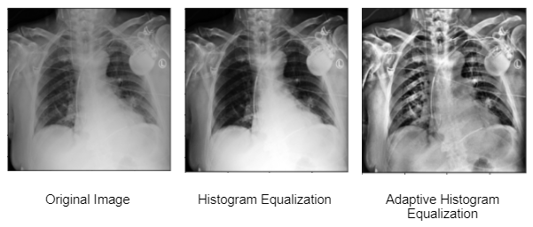

Preprocessing

Slide 9
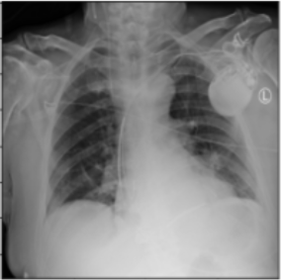


Preprocessing

Slide 10
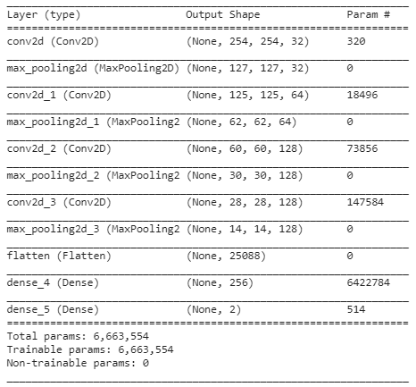
Modeling

Slide 11
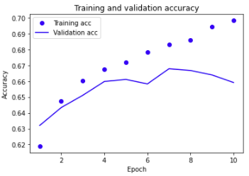
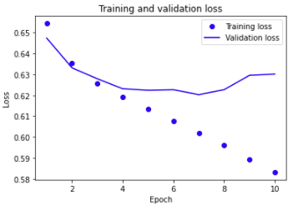
Results

Slide 12
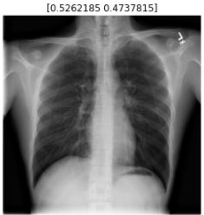
Model Prediction

Slide 13
Final Accuracy: 67%

Slide 14
Further Study
Additional preprocessing strategies
Ex. Contrast, Brightness
Train the model with a mix of image types
Rotated or randomly preprocessed images to increase model robustness
Increased model complexity

Slide 15
Thank You!
Github: https://github.com/Angad99/Chest-X-Ray-Disease-Detection
LinkedIn: https://www.linkedin.com/in/angadpfuetzner/
Email: angad.pfuetzner@mail.mcgill.ca

